Slide 1
Islam Rules To

Slide 2
WHAT IS SUCCESS

Slide 3
Google defines success as the accomplishment of an aim or a purpose.

Slide 4
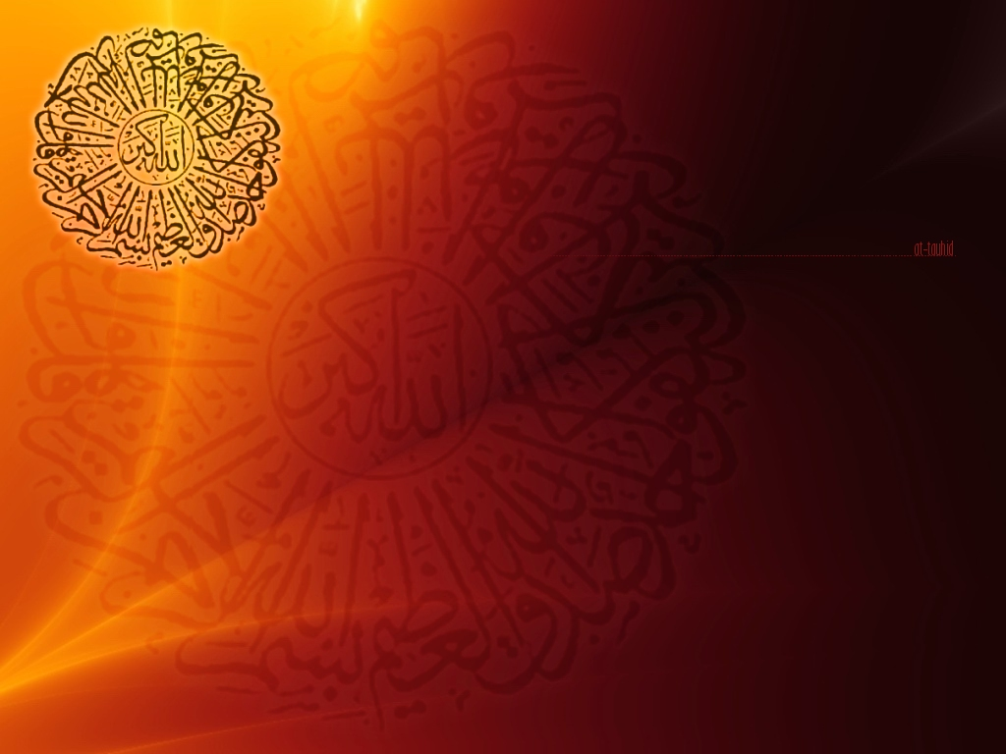
“Everyone shall taste death. And only on the Day of resurrection shall you be paid your wages in full. And whoever is removed away from the fire and admitted to Paradise, he indeed is successful. The life of this world is only a deceiving thing.” (Quran 3:185)

Slide 5
Who will be addmitted into paradise and safe from the Hell fire?

Slide 6
Who bare testimony that there is non worthy of worship but Allah, ascribe no partners unto him
And he submit his wish and his desires to the will of Allah
In other words if you are a Muslim.
A person who submit to the will of Almighty Allah will have to believe in all the Prophets of Allah and prophet Muhammad as a final messenger , all the revealed books of Allah, the angels, day of resurrection and so on…….

Slide 7
إِنَّ الدِّينَ عِندَ اللّهِ الإِسْلاَمُ
The only religion approved by Allah is "ISLAM". (Quran 3:19)
هُوَ سَمَّاكُمُ الْمُسْلِمِينَ مِنْ قَبْلُ وَفِي هَذَا
He (Allah) has named you Muslims in previous Scriptures and in this (Holy Qur’an) (Qur’an 22:78)
وَمَن يَبْتَغِ غَيْرَ الإِسْلاَمِ دِينًا فَلَن يُقْبَلَ مِنْهُ وَهُوَ فِي الآخِرَةِ مِنَ الْخَاسِرِينَ
If anyone desires a religion other than Islam , never will it be accepted of him; and in the Hereafter He will be in the ranks of those who have lost
(All spiritual good). (Quran 3:85)

Slide 8
That is why the on the day of resurrection disbelievers will say….
رُبَمَا يَوَدُّ الَّذِينَ كَفَرُوا لَوْ كَانُوا مُسْلِمِينَ

Slide 9
Question arise what about the previous nations…
Were they All Muslims
Answer is yes they were Muslims

Slide 10
Message of
Prophet Nuh عليه السلام
(Noah)

Slide 11
Prophet Noah said to his followers:
فَإِن تَوَلَّيْتُمْ فَمَا سَأَلْتُكُم مِّنْ أَجْرٍ إِنْ أَجْرِيَ إِلاَّ عَلَى اللّهِ وَأُمِرْتُ أَنْ أَكُونَ مِنَ الْمُسْلِمِينَ
If you turn away [from my message then remember] I did not ask you for any reward; my reward rests with none but Allah, for I have been commanded to be among those who are Muslims.
(Quran 10:72)

Slide 12
Message of
Prophet Ibrahim
عليه السلام
(Abraham)

Slide 13
Allah says in the Holy Qur’an while Prophet Ibrahim was building the Holy Ka’bah this was his wish and desire:
رَبَّنَا وَاجْعَلْنَا مُسْلِمَيْنِ لَكَ وَمِن ذُرِّيَّتِنَا أُمَّةً مُّسْلِمَةً لَّكَ وَأَرِنَا مَنَاسِكَنَا وَتُبْ عَلَيْنَآ إِنَّكَ أَنتَ التَّوَّابُ الرَّحِيمُ
Our Lord! make us Muslims, bowing to your (Will), and a Muslim Nation from our progeny, bowing to your (will); and show us our place for the celebration of (due) rites; and turn unto us (in Mercy); for Thou are the Oft-Returning, Most Merciful. (Quran 2:128 )

Slide 14
مَا كَانَ إِبْرَاهِيمُ يَهُودِيًّا وَلاَ نَصْرَانِيًّا وَلَكِن كَانَ حَنِيفًا مُّسْلِمًا وَمَا كَانَ مِنَ الْمُشْرِكِينَ
Ibrahim was neither a "Jew" nor a "Christian", but was a pious Muslim; and he was not of those who ascribe partners to Allah. (Glorious Quran 3:67)

Slide 15
Message of Prophet Yaqub
عليه السلام
(Jacob)

Slide 16
وَوَصَّى بِهَا إِبْرَاهِيمُ بَنِيهِ وَيَعْقُوبُ يَا بَنِيَّ إِنَّ اللّهَ اصْطَفَى لَكُمُ الدِّينَ فَلاَ تَمُوتُنَّ إَلاَّ وَأَنتُم مُّسْلِمُونَ
And this was the legacy that Ibrahim left to his sons, and so did Jacob; "Oh my sons! Allah hath chosen the Faith for you; then die not except in the Faith of Islam."
(Quran 2:132)

Slide 17
Were ye witnesses when death appeared before Jacob? Behold, he said to his sons: "What will ye worship after me?" They said: "We shall worship Thy (Lord) Allah and (that is) the (Lord) Allah of thy fathers, of Abraham, Isma'il and Isaac,the one (True) Allah & we are Muslims. (Quran 2:133)
أمْ كُنتُمْ شُهَدَاء إِذْ حَضَرَ يَعْقُوبَ الْمَوْتُ إِذْ قَالَ لِبَنِيهِ مَا تَعْبُدُونَ مِن بَعْدِي قَالُواْ نَعْبُدُ
إِلَـهَكَ وَإِلَـهَ آبَائِكَ إِبْرَاهِيمَ وَإِسْمَاعِيلَ وَإِسْحَقَ إِلَـهًا وَاحِدًا وَنَحْنُ لَهُ مُسْلِمُونَ

Slide 18
Message of Prophet Yusuf
عليه السلام
(Joseph)

Slide 19
رَبِّ قَدْ آتَيْتَنِي مِنَ الْمُلْكِ وَعَلَّمْتَنِي مِن تَأْوِيلِ الأَحَادِيثِ فَاطِرَ السَّمَاوَاتِ وَالأَرْضِ
أَنتَ وَلِيِّي فِي الدُّنُيَا وَالآخِرَةِ تَوَفَّنِي مُسْلِمًا وَأَلْحِقْنِي بِالصَّالِحِينَ
"O my Sustainer! Thou hast indeed bestowed upon me something of power, and hast imparted unto me some knowledge of the inner meaning of happenings. Originator of the heavens and the earth! Thou art near unto me in this world and in the life to come: let me die as a Muslim, and make me one with the righteous!"(Quran 12:101):

Slide 20
Message of
Prophet Musa
عليه السلام
(Moses)

Slide 21
وَقَالَ مُوسَى يَا قَوْمِ إِن كُنتُمْ آمَنتُم بِاللّهِ فَعَلَيْهِ تَوَكَّلُواْ إِن كُنتُم مُّسْلِمِينَ
And Musa said: "O my people! If you believe in God, then place your trust in Him if you are truly Muslims!“ (Noble Quran 10:84)

Slide 22
وَجَاوَزْنَا بِبَنِي إِسْرَائِيلَ الْبَحْرَ فَأَتْبَعَهُمْ فِرْعَوْنُ وَجُنُودُهُ بَغْيًا وَعَدْوًا حَتَّى إِذَا أَدْرَكَهُ الْغَرَقُ
قَالَ آمَنتُ أَنَّهُ لا إِلِـهَ إِلاَّ الَّذِي آمَنَتْ بِهِ بَنُو إِسْرَائِيلَ وَأَنَاْ مِنَ الْمُسْلِمِينَ
We brought the children of Israel (Lead by Moses) across the sea & thereupon Pharaoh & his hosts pursued them with insolence & tyranny, until when he was abut to drown, [Pharaoh] exclaimed: "I have come to believe that there is no deity but Allah in whom the children of Israel believe, & I am from Muslims.
(Quran 10:90)

Slide 23
The Followers of Prophet Musa
عليه السلام
(Moses)

Slide 24
وَمَا تَنقِمُ مِنَّا إِلاَّ أَنْ آمَنَّا بِآيَاتِ رَبِّنَا لَمَّا جَاءتْنَا رَبَّنَا أَفْرِغْ عَلَيْنَا صَبْرًا وَتَوَفَّنَا مُسْلِمِينَ
For thou take vengeance on us only because we have come to believe in our Sustainer's messages as soon as they came to us. O our Sustainer! Shower us with patience in adversity, and make us die as Muslims!" (Quran 7:126)

Slide 25
Message of
Prophet Sulaiman
عليه السلام
(Solomon)

Slide 26
إِنَّهُ مِن سُلَيْمَانَ وَإِنَّهُ بِسْمِ اللَّهِ الرَّحْمَنِ الرَّحِيمِ
أَلَّا تَعْلُوا عَلَيَّ وَأْتُونِي مُسْلِمِينَ
Behold, it is from Sulaiman (Solomon), and it says, ‘
In the name of God, the Most Gracious, Most Merciful:
Exalt not yourselves against Me, but come unto me as Muslims!’
Quran 27:31

Slide 27
فَلَمَّا جَاءتْ قِيلَ أَهَكَذَا عَرْشُكِ قَالَتْ
كَأَنَّهُ هُوَ وَأُوتِينَا الْعِلْمَ مِن قَبْلِهَا وَكُنَّا مُسْلِمِينَ
When she arrived, she was asked, "Is this thy throne?" She said, "It was just like this; and knowledge was bestowed on us in advance of this, and we are Muslims (Quran 27:42)

Slide 28
Message of
Prophet Isa عليه السلام (Jesus) and his Disciples

Slide 29
فَلَمَّا أَحَسَّ عِيسَى مِنْهُمُ الْكُفْرَ قَالَ مَنْ أَنصَارِي إِلَى اللّهِ قَالَ الْحَوَارِيُّونَ
نَحْنُ أَنصَارُ اللّهِ آمَنَّا بِاللّهِ وَاشْهَدْ بِأَنَّا مُسْلِمُونَ
When Isa found Unbelief on their part (of his disciples) He said: "Who will be My helpers to (in conveying the message) Allah." Said the disciples: "We are Allah's helpers: We believe in Allah, and do you bear witness that we are Muslims. (Glorious Quran 3:52)
وَإِذْ أَوْحَيْتُ إِلَى الْحَوَارِيِّينَ أَنْ آمِنُواْ بِي وَبِرَسُولِي قَالُوَاْ آمَنَّا وَاشْهَدْ بِأَنَّنَا مُسْلِمُونَ
AND [remember the time O Son of Mary] when I (Allah)
inspired the white-garbed ones (Disciples of isa PBUH):
Believe in Me and in My Prophet!" They answered:
"We believe; and you bear witness that we are Muslims.
(Quran 5:111 (

Slide 30
The End

